Slide 1

Microservices in a DevOps context
A review of “A Systematic Mapping Study on Microservices Architecture in DevOps”
Christoph Bühler
MSE Seminar “Design Science and Empirical Software Engineering”

Slide 2
Agenda
Introduction / Definitions
Summary
Critical Review

Slide 3
What about questions?
If something comes up, please do not hesitate to ask directly

Slide 4

Introduction
…into the topic
MSE Seminar “Design Science and Empirical Software Engineering”
Christoph Bühler

Slide 5
Design Science
Introduction
Achieve knowledge and a general understanding
Guidelines according to Alan R. Hevner et al.
Design as an artifact
Problem relevance
Design evaluation
Research contributions
Research rigor
Design as a search process
Communication of research
Notes:
Design as an artifact: Design Science must produce an artifact
Problem relevance: The objective is to develop solutions to relevant business problems
Design evaluation: The usefulness of an artifact must be demonstrated with evaluation methods
Research contributions: It must provide clear and verifiable contributions to the topic
Research rigor: The research relies on rigorous methods in construction and evaluation of the model
Design as a search process: The search for artifacts requires satisfying laws to be in place
Communication of research: The targeted audience should be technology based as well as management based

Slide 6
Empirical Software Engineering
Introduction
Base for discussion
Methods for empirical research
Systematic Mapping Study (SMS)
Systematic Literature Review (SLR)
Systematic Gray Literature Review (SGLR)
Notes:
Empirical: include various results and derive new solutions / problems / insights from it
SMS:
defined method to gather, analyze, classify, structure a field of interest
Steps:
Define Research Questions
Define Search Query and Params
Search for publications
Analyze and screen the results
Classify and map the results
SMS is on a wider / broader scale
SLR:
Systematic analyzation and review of secondary data
Goes into depth of a topic (in contrary to the SMS)
SGLR:
Same as SLR, but with gray literature
Gray literature: non peer-reviewed literature (like blogs etc)

Slide 7
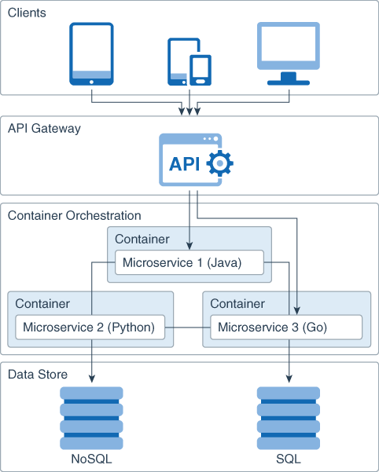
Microservices
Introduction
Application structural style
Build several small services that cooperate
Often deployed to distributed systems
Fine-grained, isolated
Multiple paradigms
Containerized
Highly automated
Notes:
Also: domain driven
Lean holistic (DEVOPS)
Automated CI/CD

Slide 8
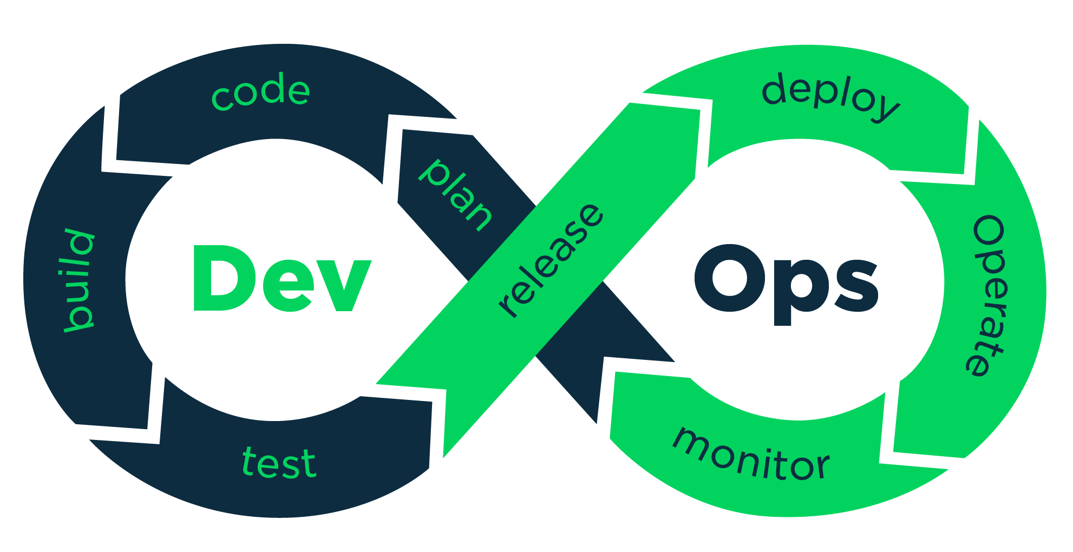
DevOps
Introduction
Set of practices
Reduce the time for changes to land in production
Maintain a high quality of the software
Cooperates nicely with agile software techniques

Slide 9
Summary
…of the study
MSE Seminar “Design Science and Empirical Software Engineering”
Christoph Bühler

Slide 10
A Systematic Mapping Study on Microservices Architecture in DevOps
Summary
SMS conducted by Muhammad Waseem, Peng Liang and Mojtaba Shahin
Methodology
Plan the study
Collect and analyze data
Map and document the results
Notes:
Motivation: Find problems and corresponding solutions to the topic
Find research challenges, classification for tools and description tools

Slide 11
Research Questions (1/2)
Summary
Demography, Classification and Mapping
Problems, Solutions and Challenges
What is the frequency and type of published research on MSA in DevOps?
What are the existing research themes on MSA in DevOps and how can they be classified and mapped?
What problems have been reported when implementing MSA in DevOps?
What solutions have been employed to address the problems?
What challenges have been reported when implementing MSA in DevOps?

Slide 12
Research Questions (2/2)
Summary
Description methods and patterns
Tool support and application domains
What methods are used to describe MSA in DevOps?
What MSA design patterns are used in DevOps?
What quality attributes are affected when employing MSA in DevOps?
What tools are available to support MSA in DevOps?
What are the application domains that employ MSA in DevOps?

Slide 13
Search for publications
Summary
Two-phase-search
Classic search with a constructed search-term
Snowballing
Search from January 2009 until July 2018
Only peer-reviewed material
Two search queries
(microservi* OR micro-servi*) AND (architect* OR design OR structur*) AND DevOps
(microservice AND DevOps)
Notes:
Forward Snowballing: take studies that cite the found studies
Backward Snowballing: take studies that are referenced in found studies
Note for July 2018, and the “DevOps” part
DevOps is not constructed (which is in critique)

Slide 14
Search results
Summary
Total of 494 studies (search and snowballing)
After testing for relevancy: 285 relevant studies remained
After screening: 117 studies remained
After reading and scoring: 47 remained
Notes:
Screening:
English?
Book?
Peer-Reviewed?
Secondary study?
QA:
- Are the problem definition and motivation of the study clearly presented?
Is the research environment in which the study was conducted clearly explained?
Is the research method used for the study clearly presented?
Are the insights and lessons learned from the study explicitly mentioned?
Are the limitations of the study explicitly discussed
Does the study focus on MSA in DevOps?
Does the study present problems, solutions, and challenges in the context of MSA and DevOps combination?
- Does the study present MSA description methods, MSA design patterns, QAs, and tools in the context of MSA
and DevOps combination?

Slide 15
Demography and Classification
Summary
Relevant publications were between 2015 and 2018
The topic grew important in the years 2017 and 2018
Top three venues
Internet, Cloud and Services Computing
Software Engineering
Telecommunication and Networks
Notes:
Also, multi-disciplinary computing was on place 3 with telecom.
Sums:
Workshop: 4
Journals: 12
Books: 8
Confs: 23

Slide 16
Problems, Solutions and Challenges
Summary
Requirements of MSA-based Systems
Design of MSA-based Systems
Implementation of MSA-based Systems
Testing of MSA-based Systems
Deployment of MSA-based Systems
Monitoring of MSA-based Systems
Organizational Problems
Resource Management Problems
Notes:
These are the listed “categories” of problems.
Examples:
Requirements:
Performance Issue due to Lack of Dedicated Access to the Host’s Hardware
Scaling MSA-based Systems
Design:
Application Decomposition into Microservices
Security and Privacy Across Cloud-Native Applications
Implementation:
Managing and Migration Legacy Databases
Operational and Configuration Complexity
Testing (in general)
Deployment:
Frequent Deployment in Different Environments
Complexity in the Dynamic Deployment
Monitoring:
Logging and Post-Deployment Monitoring
Monitoring Microservices at Run Time
Organizational:
Introducing DevOps and MSA Culture
Resource Management for deployment, dev and stuff

Slide 17
MSA description methods and patterns
Summary
Boxes and Lines (without any specific framework)
UML
Formal Method (π-Calculus or equivalent)
ADL
Other:
ERD
BPMN
Notes:
UML: unified modeling language
ADL: architecture description language
ERD: entity relationship diagram
BPMN: business process modeling notations

Slide 18
Quality Attributes
Summary
Notes:
These are the – according to the study – affected quality attributes
When using MSA in the DevOps context

Slide 19
Tools and application domains
Summary
Notes:
App domains “others”:
Each with one study:
Healthcare software
Webserver
Distributed system
Autonomic Management System
Betting and Gaming
Web Blog
eServices Developments
Container Management System
Content Management
Software for non-profit

Slide 20
Discussion
Summary
Research status
Problems and solutions
Rise of interest from 2015 onward
Most topics
Tools
Approaches
Development and Deployment
Many different solutions with design patterns, guidelines and frameworks
No studies found that address testing

Slide 21
Discussion
Summary
Challenges
Description methods
Performance of MSA based systems
Security in distributed systems
Informal boxes and lines
UML

Slide 22
Discussion
Summary
Application domains
~33% of the publications did not state any specific application domain
Runner-up: “Software Development Tools and Frameworks”

Slide 23
Review
…of the study
MSE Seminar “Design Science and Empirical Software Engineering”
Christoph Bühler

